Slide 1
Neural Networks - Basics

Slide 2
Introduction
A neural network is simply a function that takes in an input X and computes an output Y.
What sets it apart from a function such as, say y = sin(X), is the manner in which it is constructed.
It is composed as a network of many, very simple elements that together somehow manage to perform complex tasks.
The term “neural” itself derives from the fact that the simple units that are networked to compose the model are conceptually similar to neurons in the brain, and were in fact originally designed as models for these neurons.

Slide 3
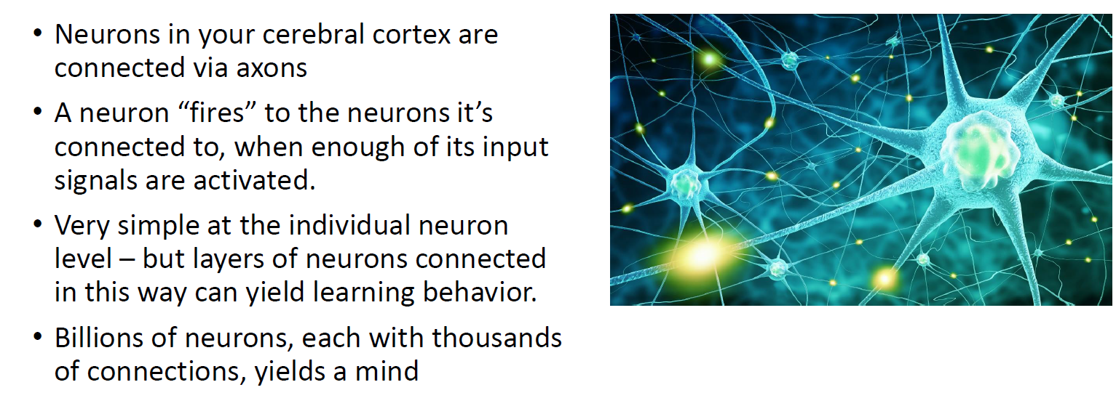
The Biological Inspiration

Slide 4
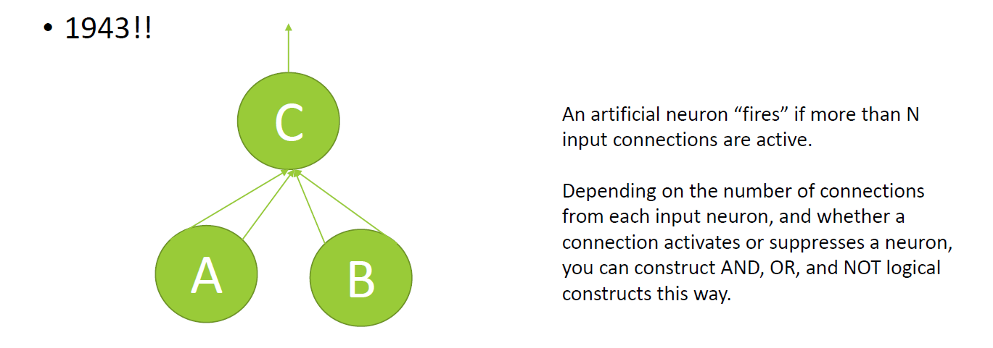
The First Artificial Neuron

Slide 5
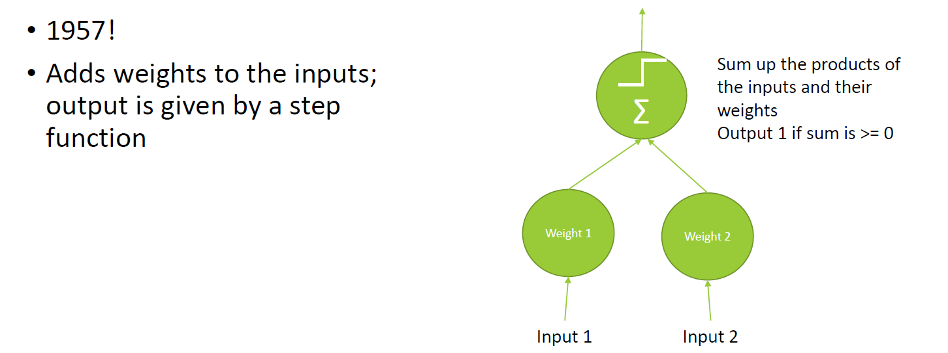
Linear Threshold Unit (LTU)

Slide 6
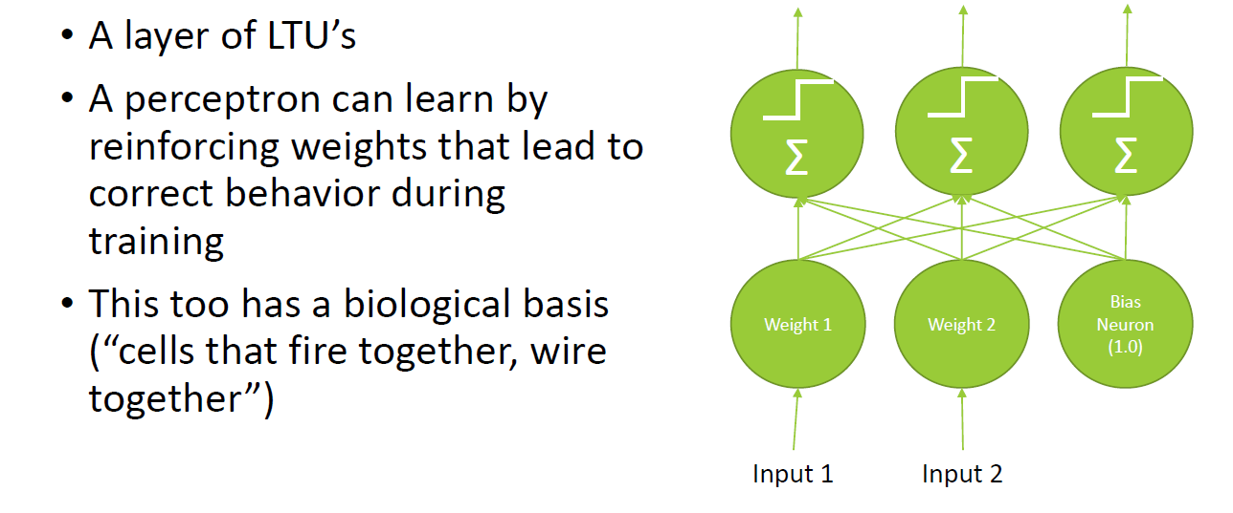
Perceptron
Developed by Frank Rosenblatt

Slide 7
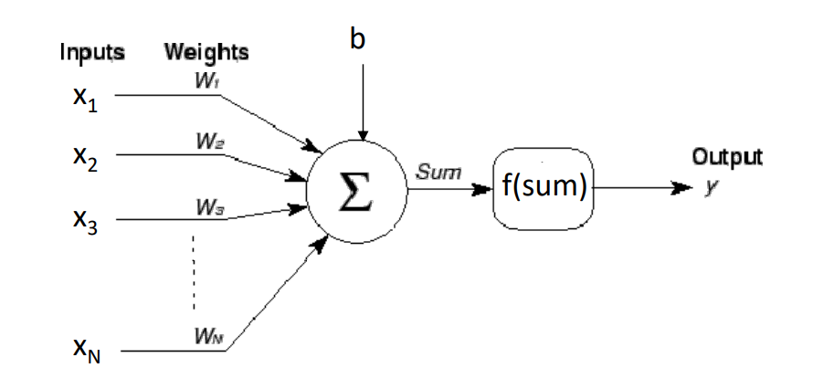
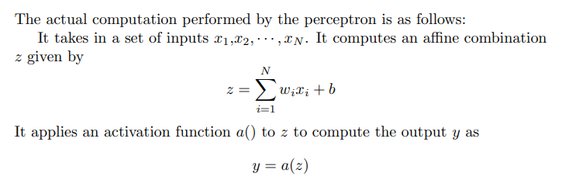
Perceptron

Slide 8
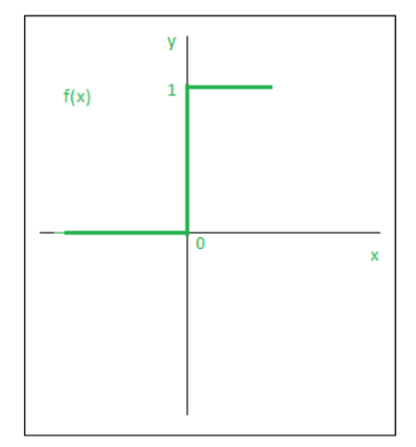
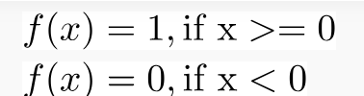
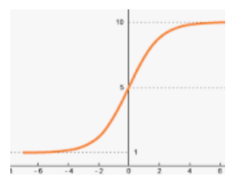
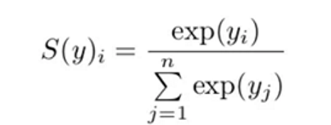
Activation Functions
Activation function of a node defines the output of that node given an input or set of inputs. Activation functions decide whether a neuron should be activated or not by calculating the weighted sum and further adding bias to it.
Step Function is one of the simplest kind of activation functions. In this, we consider a threshold value and if the value of net input say y is greater than the threshold then the neuron is activated.
SoftMax is an activation function that scales numbers/logits into probabilities. It is often used as the last activation function of a neural network to normalize the output of a network to a probability distribution over predicted output classes.

Slide 9
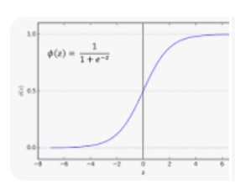
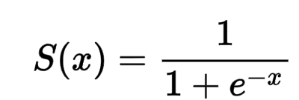
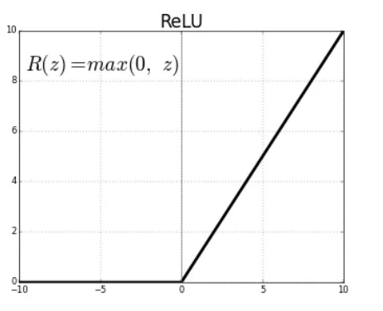
Activation Functions
Sigmoid Function takes any real value as input and outputs values in the range of 0 to 1. The larger the input (more positive), the closer the output value will be to 1.0, whereas the smaller the input (more negative), the closer the output will be to 0.0
The rectified linear activation function or ReLU is a non-linear function or piecewise linear function that will output the input directly if it is positive, otherwise, it will output zero.
f(x) = max (0,x)

Slide 10
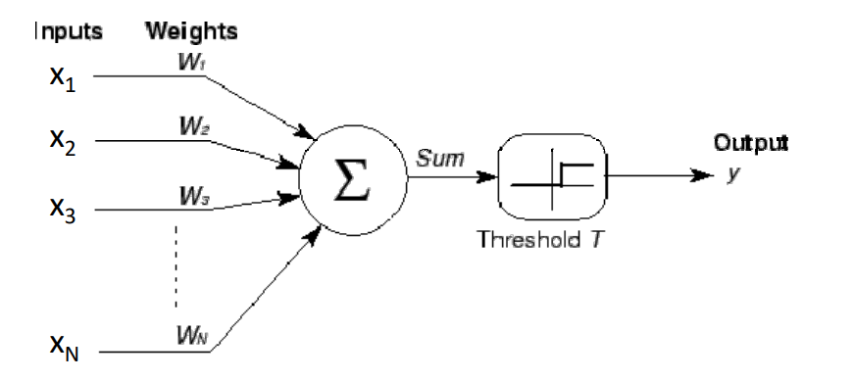
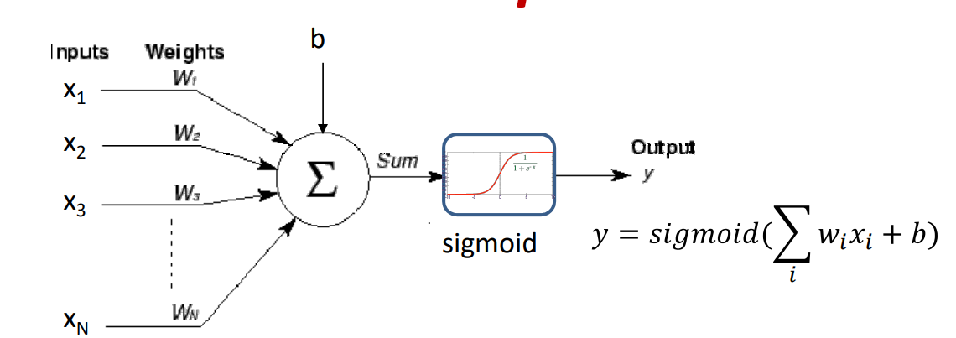
Perceptron Outputs
Output: Boolean
Output: Real

Slide 11
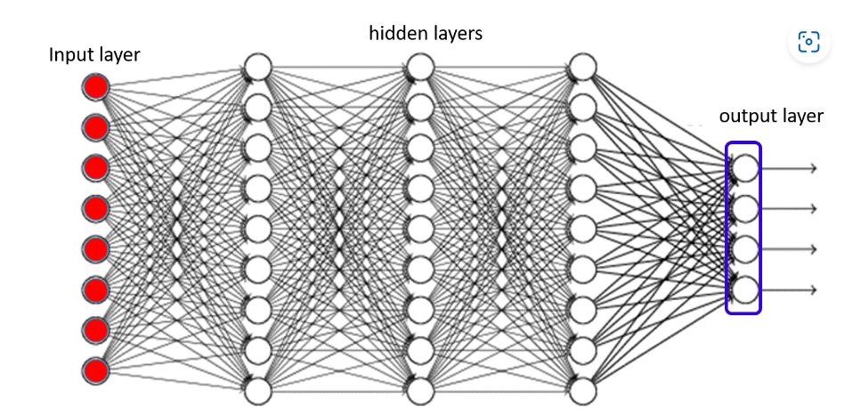
Multi-layer Perceptron
The MLP must take in an input (comprising components x₁, · · · , x_{N}) and compute the output (comprising components y₁, · · · , y_{M}).
The computation of the MLP is preformed sequentially from the neurons closest to the input, progressing until the neurons at the output, in such a manner that when each neuron is evaluated, all of the values it requires as input are already evaluated.

Slide 12
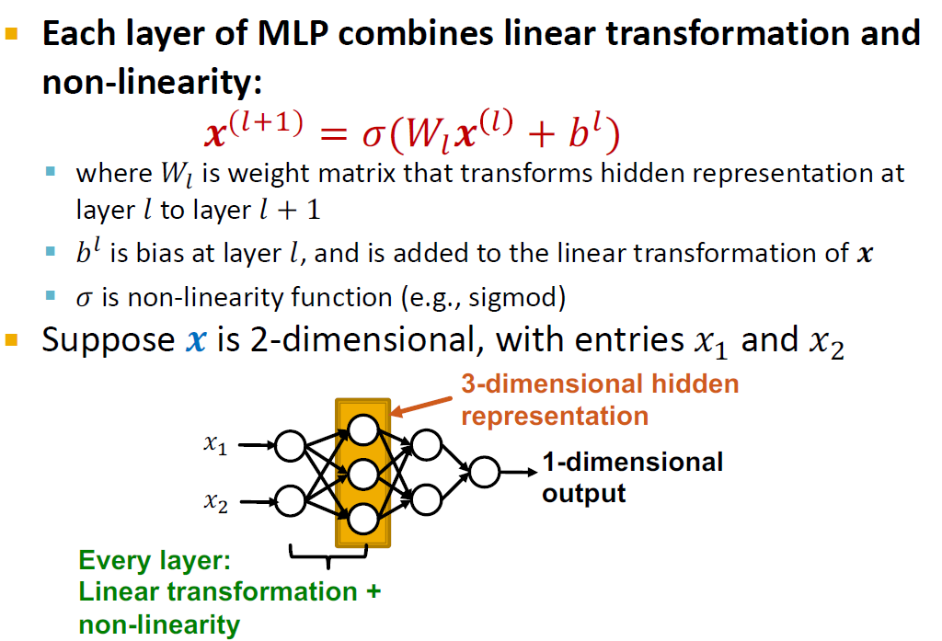
Multi-layer Perceptron
Note: Adding the bias term provides more flexibility and better generalization to the neural network model

Slide 13
Training
To ensure that the output is correct we must train the neural network.
The network has a number of parameters: the weights and the biases.
The behavior of the network changes according to their value.
“Training” the network is the process of learning these values, such that the network performs it tasks correctly.
The actual training process is an iterative process, in which we begin with initial estimates for all the parameters (which may be randomly set).
These estimates are then iteratively refined such that the network outputs (mostly) correct answers to a set of “training” instances for which the answers are known.

Slide 14
Training Iterative Process
In Forward Propagation each training instance x_{i} is passed through the network to obtain the output y_{i}
A loss function is a function that compares the target and predicted output values
Measures how well the neural network models the training data
Back propagation is a process involved in the training
For each training instance, we compute backward from the output layer of the network to the input layer
It involves taking the error rate of a forward propagation and feeding this loss backward through the neural network layers to fine-tune the weights.

Slide 15
Limitations - ANN
When you have data that doesn’t neatly align into columns
Images that you want to find features within
Machine translation
Sentence classification
Find features that aren’t in a specific spot
Like a stop sign in a picture
Or words within a sentence
Feature location invariant – Spatial Invariance

Slide 16
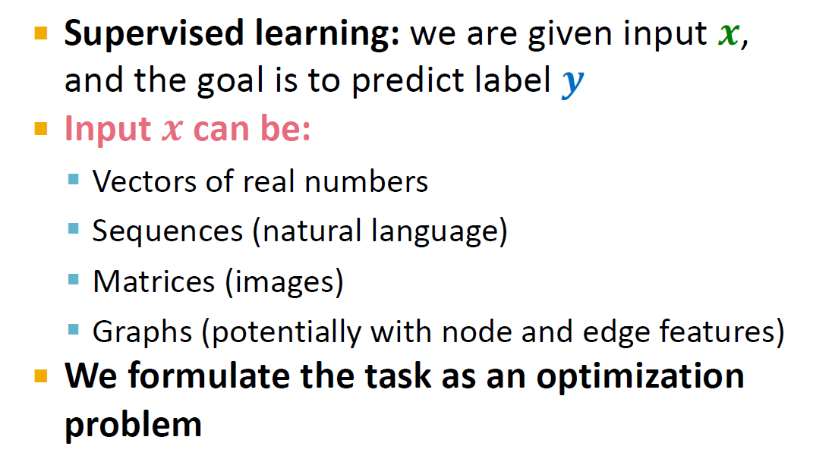
Neural Network as Optimization

Slide 17
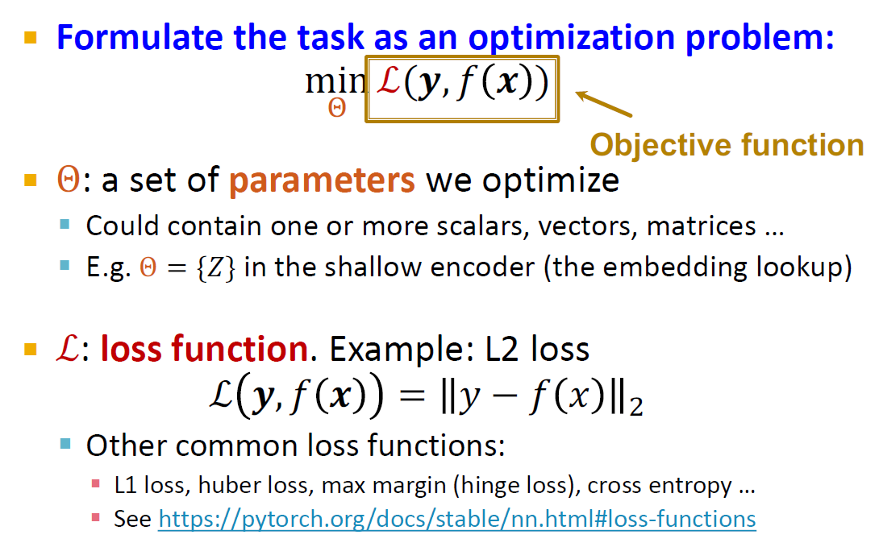
Neural Network as Optimization

Slide 18
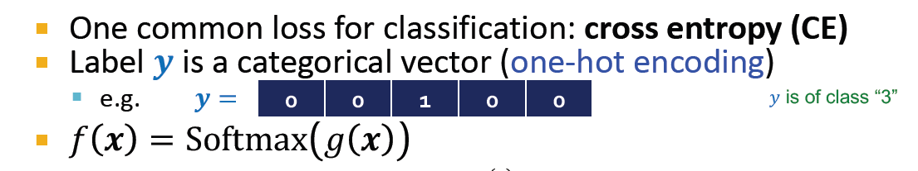
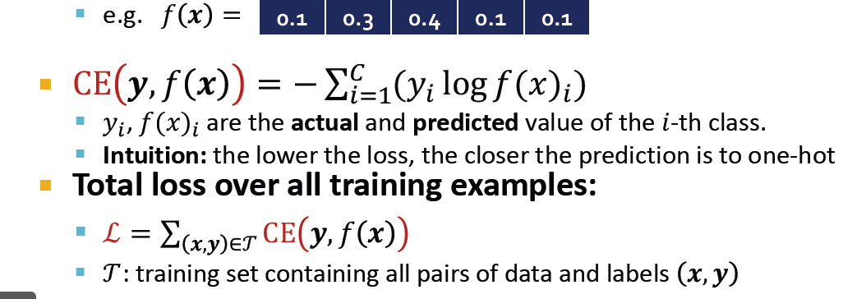
Loss Function: Example

Slide 19
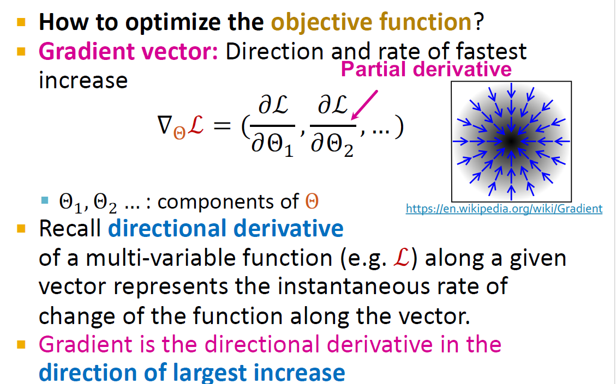
Neural Network as Optimization

Slide 20
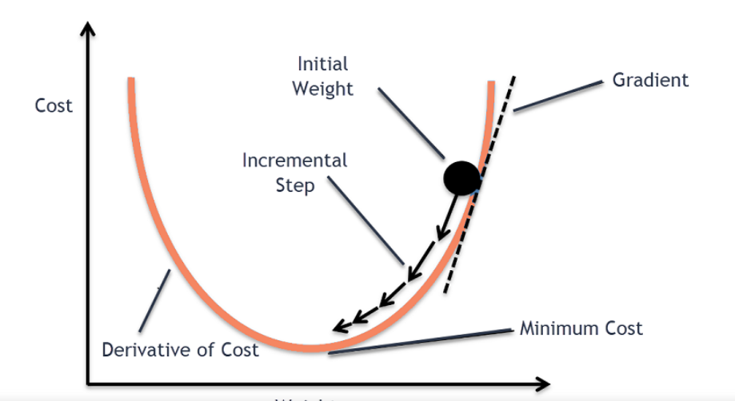
Gradient Descent
Gradient descent is an iterative first-order optimisation algorithm used to find a local minimum/maximum of a given function.
Gradient Descent Algorithm iteratively calculates the next point using gradient at the current position, scales it (by a learning rate) and subtracts obtained value from the current position (makes a step).

Slide 21
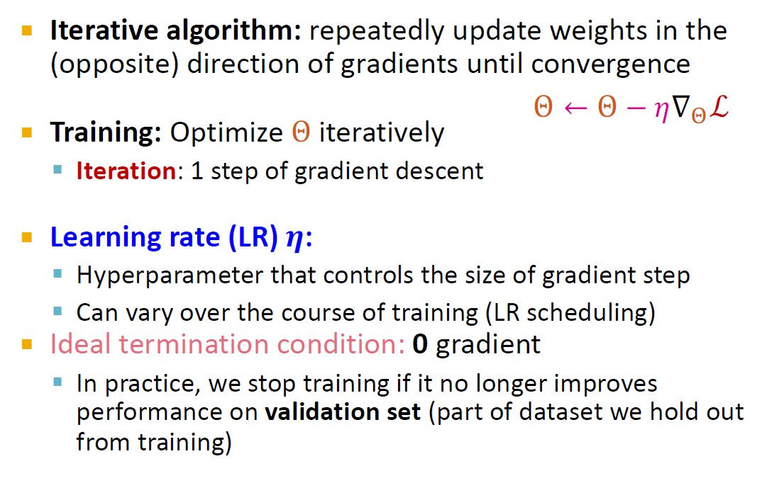
Gradient Descent

Slide 22
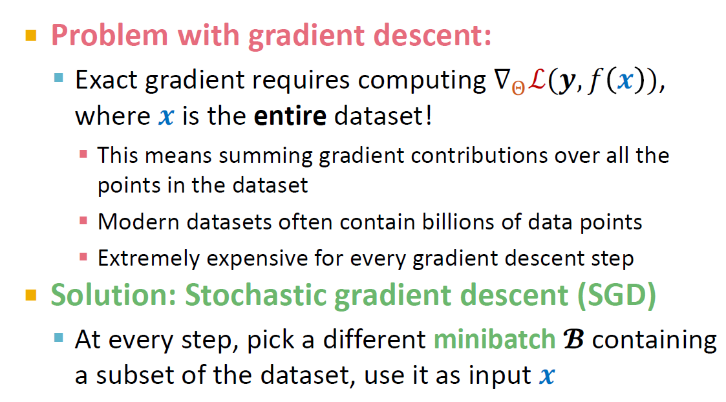
Stochastic Gradient Descent

Slide 23
Stochastic Gradient Descent
Stochastic Gradient Descent (SGD) is a variant of the Gradient Descent algorithm
It addresses the computational inefficiency of traditional Gradient Descent methods when dealing with large datasets in machine learning projects.
In SGD, instead of using the entire dataset for each iteration, only a single random training example (or a small batch) is selected to calculate the gradient and update the model parameters.
This random selection introduces randomness into the optimization process, hence the term “stochastic” in stochastic Gradient Descent
The advantage of using SGD is its computational efficiency, especially when dealing with large datasets.
By using a single example or a small batch, the computational cost per iteration is significantly reduced compared to traditional Gradient Descent methods that require processing the entire dataset.

Slide 24
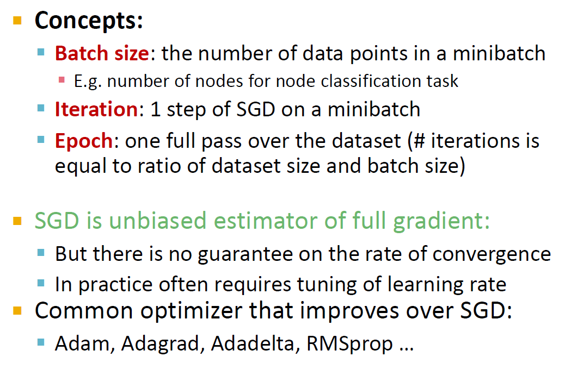
Minibatch SGD

Slide 25
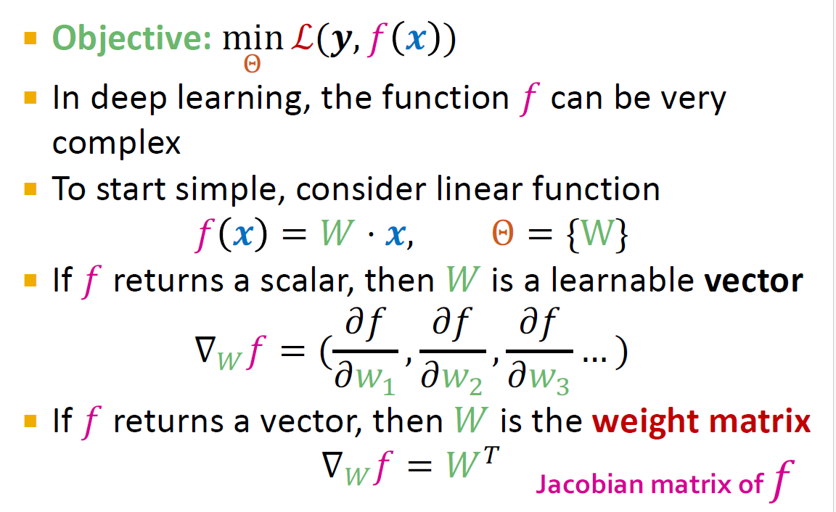
Neural Network Function

Slide 26
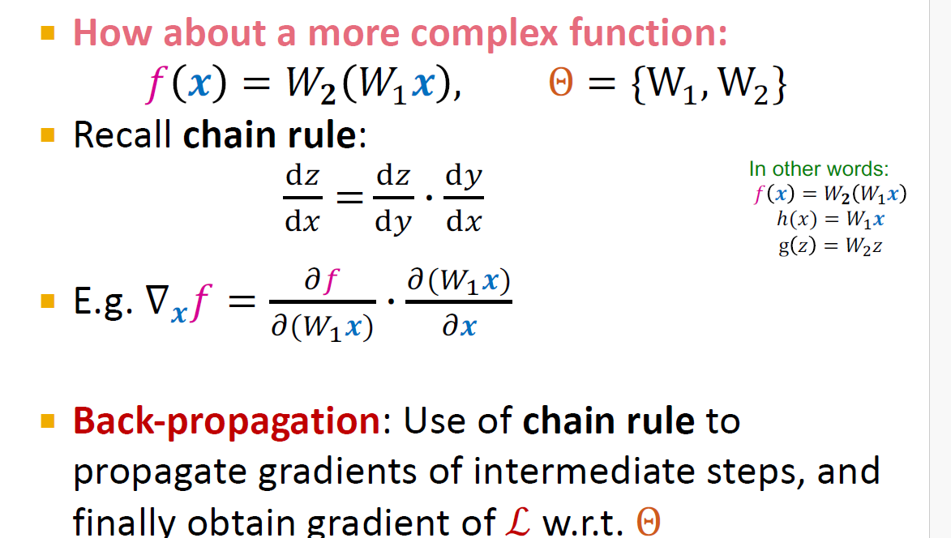
Back Propagation

Slide 27
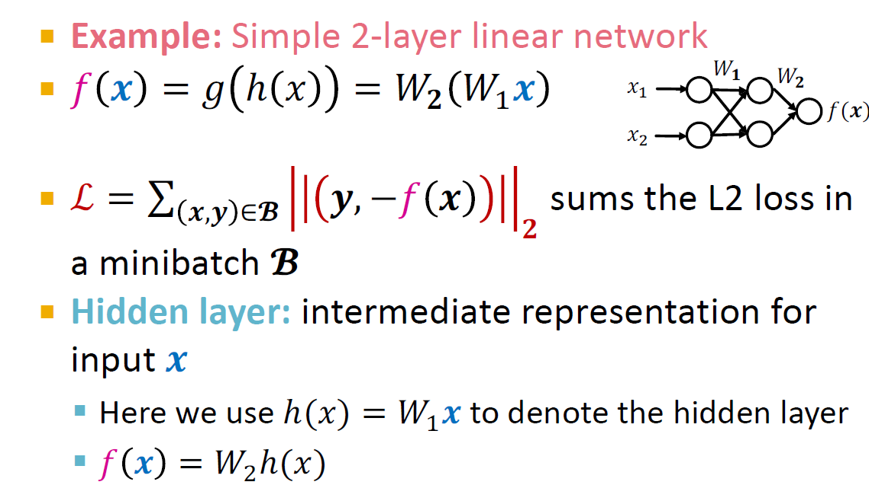
Back Propagation: Example

Slide 28
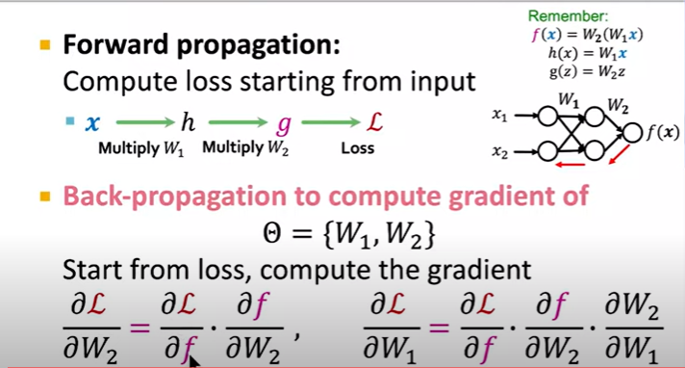
Back Propagation: Example

Slide 29
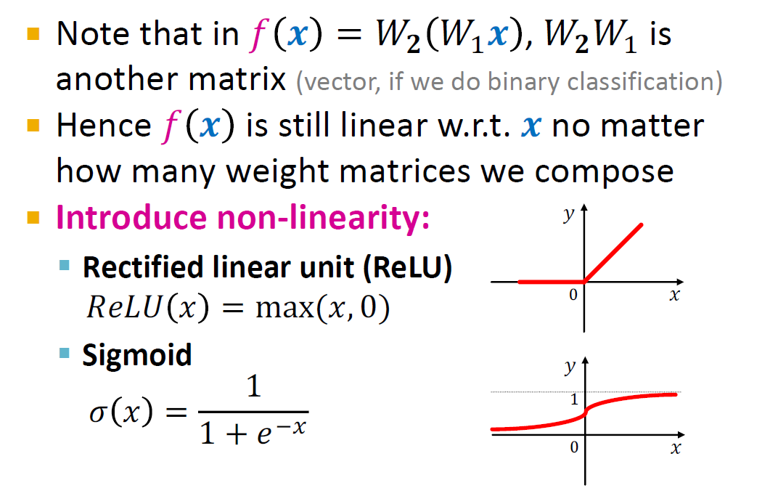
Non-linearity
This nonlinearity allows neural networks to develop complex representations and functions based on the inputs that would not be possible with a simple linear model.

Slide 30
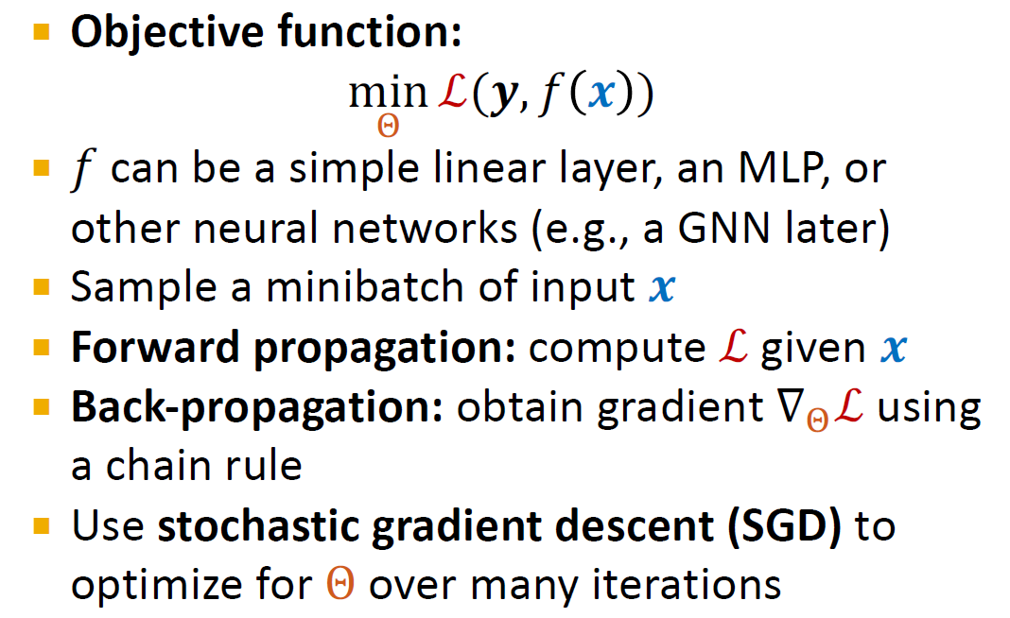
Summary

Slide 31
Convolutional Neural Network
Inspired by the biology of the visual cortex
Local receptive fields are groups of neurons that only respond to a part of what your eyes see (subsampling)
They overlap each other to cover the entire visual field (convolutions)
They feed into higher layers that identify increasingly complex images
Some receptive fields identify horizontal lines, lines at different angles, etc. (filters)
These would feed into a layer that identifies shapes
Which might feed into a layer that identifies objects
For color images, extra layers for red, green, and blue

Slide 32
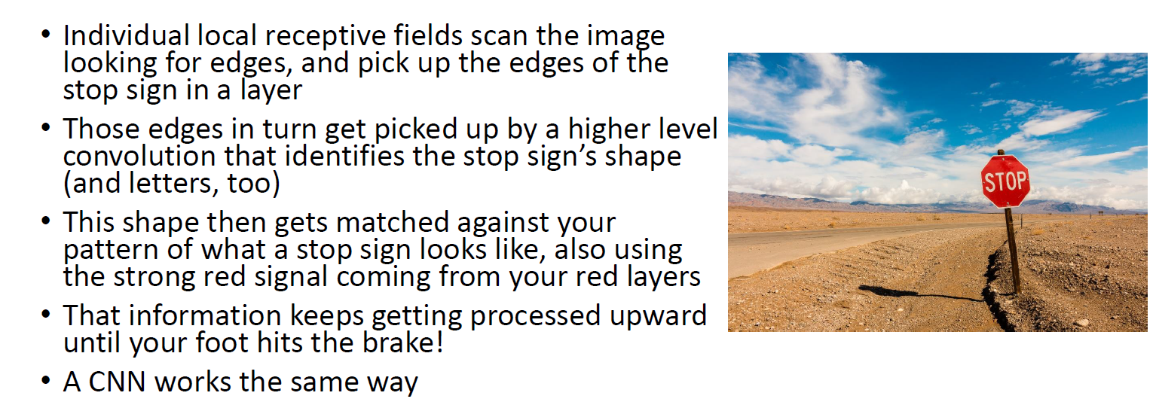
How do we know that’s a Stop sign?

Slide 33
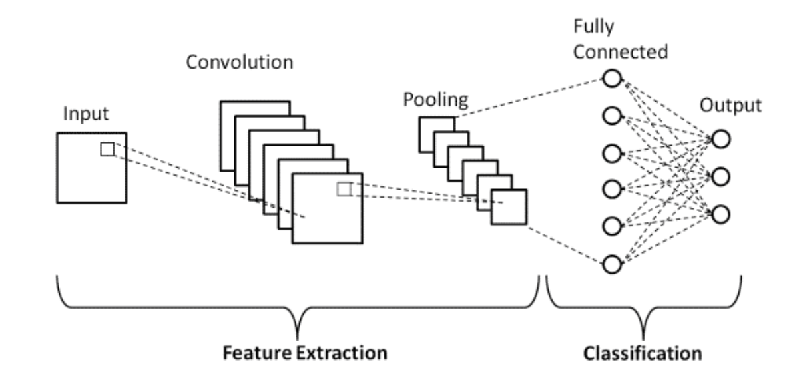
CNN - Architecture

Slide 34
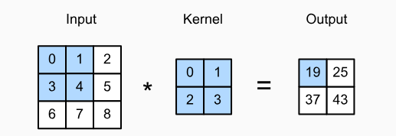
CNN - Components
Convolution Layer
This layer is the first layer that is used to extract the various features from the input images. In this layer, the mathematical operation of convolution is performed between the input image and a filter of a particular size MxM. By sliding the filter over the input image, the dot product is taken between the filter and the parts of the input image with respect to the size of the filter (MxM).
The output is termed as the Feature map which gives us information about the image such as the corners and edges. Later, this feature map is fed to other layers to learn several other features of the input image.
Pooling Layer
A Convolutional Layer is followed by a Pooling Layer. The primary aim of this layer is to decrease the size of the convolved feature map to reduce the computational costs. This is performed by decreasing the connections between layers and independently operates on each feature map. Depending upon method used, there are several types of Pooling operations. It basically summarizes the features generated by a convolution layer.
In Max Pooling, the largest element is taken from feature map. Average Pooling calculates the average of the elements in a predefined sized Image section. The total sum of the elements in the predefined section is computed in Sum Pooling. The Pooling Layer usually serves as a bridge between the Convolutional Layer and the FC Layer.
Fully Connected Layer
The Fully Connected (FC) layer consists of the weights and biases along with the neurons and is used to connect the neurons between two different layers. These layers are usually placed before the output layer and form the last few layers of a CNN Architecture.
In this, the input image from the previous layers are flattened and fed to the FC layer. The flattened vector then undergoes few more FC layers where the mathematical functions operations usually take place. In this stage, the classification process begins to take place.

Slide 35
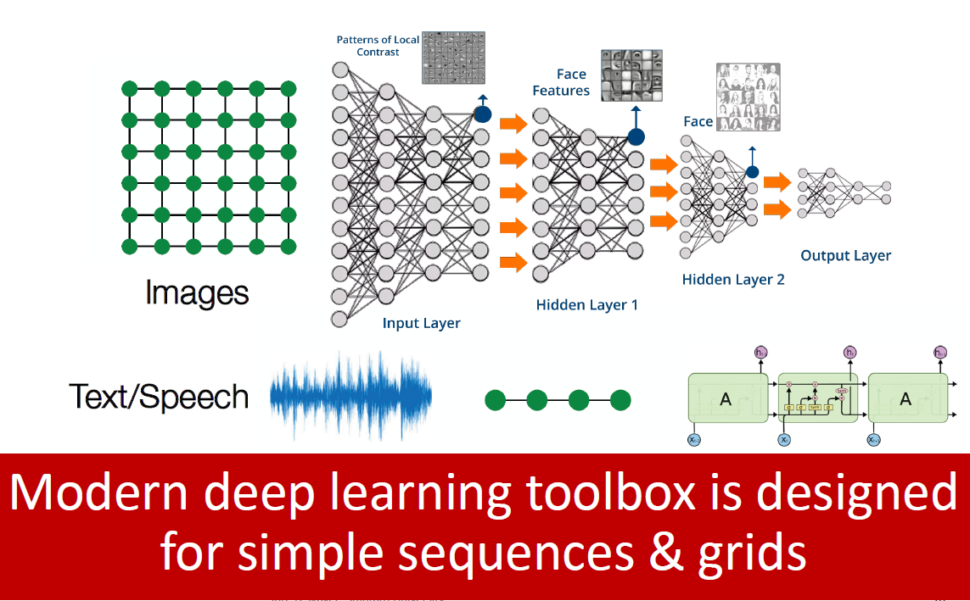
Modern ML Toolbox

Slide 36
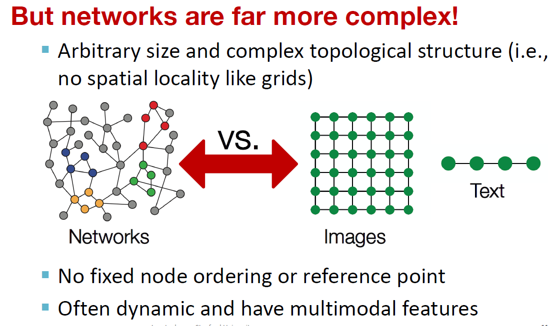
Limitations
Need new architectures for Graphs

